Slide 1
Preparing for AITSL accreditation
Lee FitzGerald
Lecturer, Teacher Librarianship
School of Information Studies
Charles Sturt University.

Slide 2
Notes:
These are the evidence guides produced by ASLA which link with the Australian Teaching standards, to allow TLs to consider how they will meet accreditation standards at the various levels. Each standard is listed, with an explanation, then some examples of evidence that TLs might bring to bear upon achieving this level. The examples of evidence are not prescriptive, and I suggest further on in this presentation some more examples from GI evaluation that might fit Standard 5. Assess, provide feedback and report on student learning. The Evidence guides are intended to give the teacher librarian a sense of how he/she might meet that standard.

Slide 3
Notes:
So, I’ve extracted the most relevant parts of Standard 5 for our purposes.
1. Provide feedback on student learning. The language in very much the same as that of GI, strategies for intervention, providing feedback on student progress.

Slide 4
Notes:
These are the examples suggested by ASLA.
Feedback loop is relevant in GI
Student self assessment as part of the ongoing reflective practice which is a hall mark of GI.

Slide 5
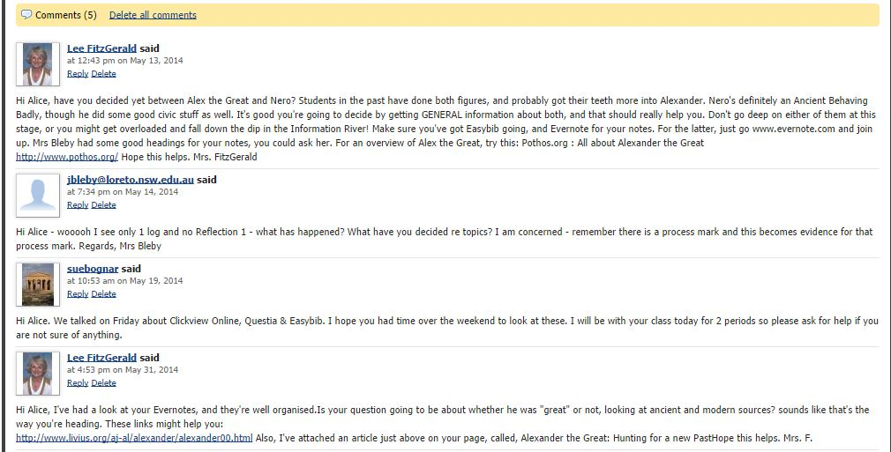
Evidence: Feedback from teachers and teacher librarians
Notes:
This is an example of the kind of feedback in GI that could be used as evidence of achieving standard 5.2.
Wiki feedback provides a different environment for formative assessment and feedback from face to face feedback also an intrinsic part of GI, and is usable as evidence, more than face to face feedback, which is transitory.

Slide 6
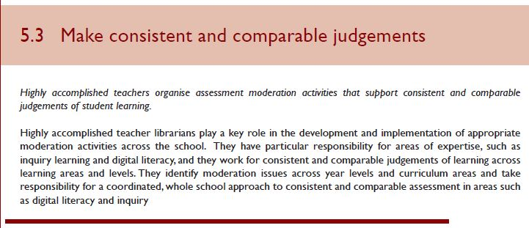
Notes:
So this is Standard 5.3: Make consistent and comparable judgments

Slide 7
Notes:
These are the examples of evidence for 5.3
All of them are involved in a GI.

Slide 8
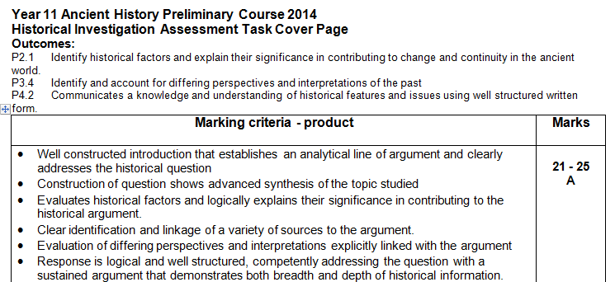
Assessment - Product
Notes:
This is a snip from the marking criteria for product of a GI, which is obvious evidence of achievement of learning outcomes. In a GI, the teacher is responsible for this, while the TL, actively involved throughout, might do some cross marking.

Slide 9
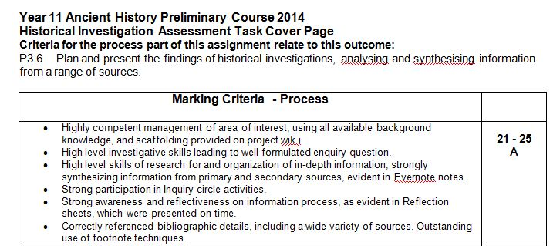
Evidence: Assessment - Process
Notes:
These are the marking criteria for process – equal marks with product. If these were built into every GI a student does, with equal weight given to process, they become a record of evidence of achievement of learning outcomes relating to process, and provide a consistent level of evidence of the TL’s contribution to the achievement of standard 5.3 – make consistent and comparable judgments.
Process components in this GI were:
Use of wiki, use of Evernotes,
Well formulated inquiry question
Participation in inquiry circles
Use of reflection sheets
Bibliography and footnotes.
Teacher librarian responsible for the marking of process. This is solid evidence of contribution to student learning.

Slide 10
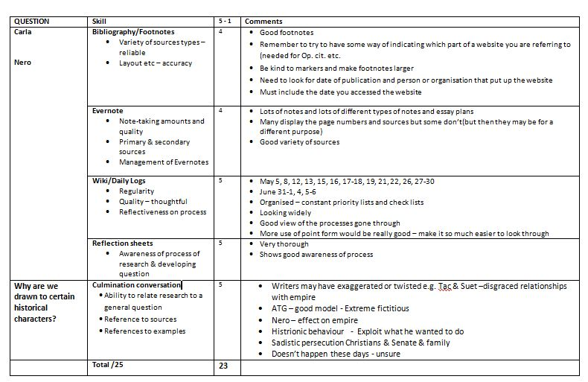
Evidence: Assessment - process
Notes:
This is a report filled out for each student in a Year 11 GI by the TL, and shows student by student analysis of achievement of process outcomes. Very useful evidence.

Slide 11
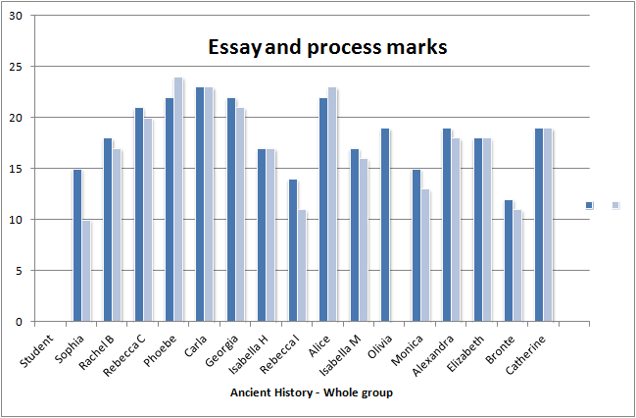
Evidence: Assessment - process
Notes:
This is a slide from an Ancient Historical investigation at Loreto, showing content and process marks contributed by teacher and TL, a solid piece of evidence of the TL’s contribution to the assessment of student learning.

Slide 12
Notes:
This standard 5.4 is about interpreting student data.
It is about using and interpreting student data developed from student assessments, etc.
I’m suggesting that this is where using the SLIM Toolkit can be used as evidence of achievement of this standard.

Slide 13
Evidence of interpreting student data: SLIM (School Library Impact Measure) Toolkit
Q1: Take some time to think about your topic. Now write down what you know about it.
Q2: How interested are you in this topic? Not at all/Not much/Quite a bit/A great deal
Q3: How much do you know about this topic? Nothing/ Not much/Quite a bit/A great deal.
Q4: When you do research, what do you generally find easy to do?
Q5: When you do research, what do you generally find difficult to do?
Q6: What did you learn in doing this research project?
Notes:
This is the SLIM toolkit which can be used as the reflective instrument in a GI, and data from this can be analysed and used as evidence of analysing student data. It is presented to students at beginning, middle and end of the task. It is the SLIM Toolkit - Student learning through inquiry measure – from Professor Ross J Todd of Rutgers University.

Slide 14
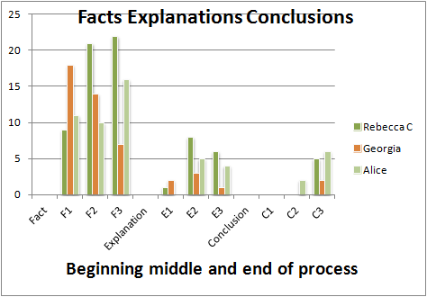
Evidence of growth of deep knowledge
Notes:
This graph is an example of responses to Question 1 of the SLIM toolkit. It shows three students in the top range (for essay and process marks) and the number of facts, explanations and conclusions they had at the three gathering points.
The move we are looking for from lots of facts at the beginning, diminishing at the second and third collection points into a smaller but clear growth of explanations and conclusions is evident here.
It can be used for evidence of the achievement of individual students in developing deep understanding of their topic.

Slide 15
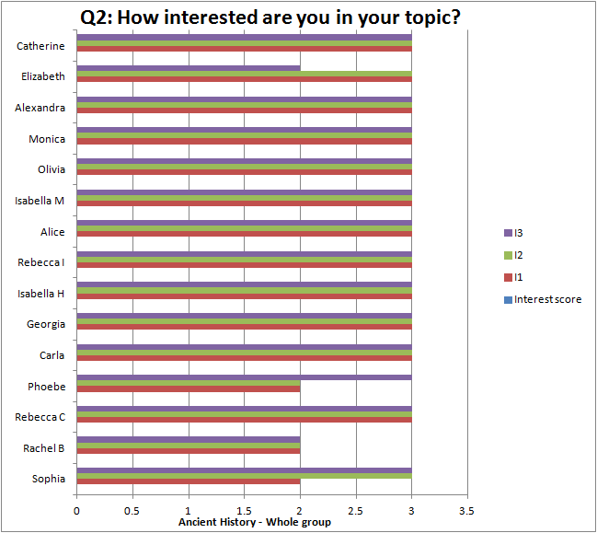
Evidence of interest
Notes:
This is question 2 given to students at beginning, middle and end of project.
They could choose not at all, not much, quite a bit, a great deal
This is an excellent finding, as it shows a majority of students expressing unwavering interest throughout the project.
Students with the three colours filled in completely have said that they were a great deal interested throughout the process.
Three diminished interest, but only to quite a bit.
This is evidence of deep interest of students in their inquiry and can used as evidence for achievement of standard 5.4, relating to analysis of student data.

Slide 16
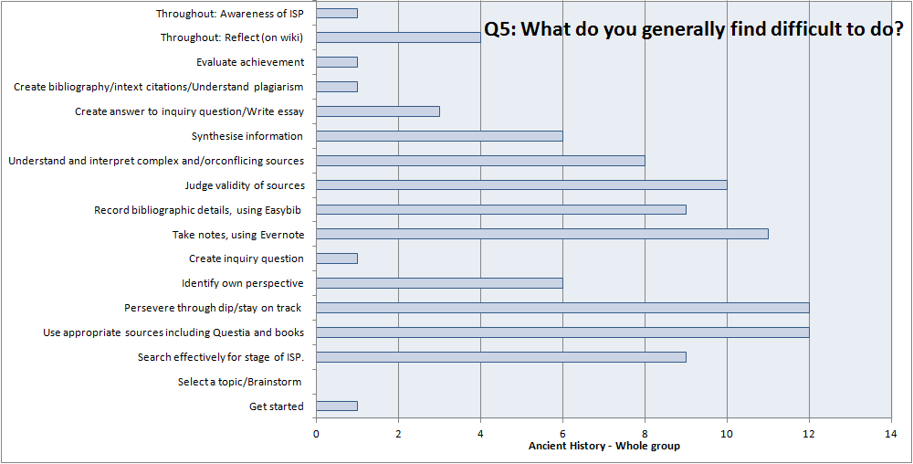
Evidence of difficulties
Notes:
This is a sample answer to question 5: What do you generally find difficult to do?
Interesting range of difficulties here –
Shows the knowledge that students have gained of the ISP
They could articulate that it is difficult to persevere through the dip and to stay on track, and to search effectively for the stage of the ISP. They articulate that they find it difficult to use complex sources, to judge validity of sources, to take notes,
This is useful information for framing interventions and is good evidence for achievement of Standard 5.4 analyse student data.

